Slide 1
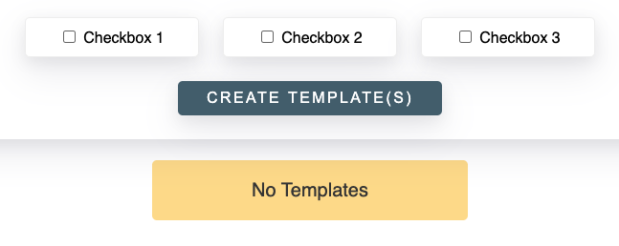
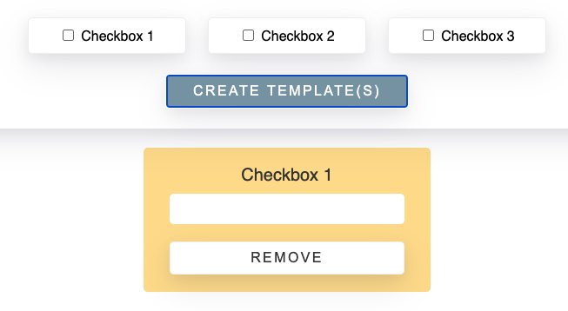
Challenge is to create a component(s) that creates and deletes templates for the user.
Starting state
Expected result

Slide 2
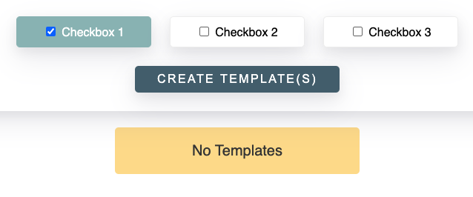
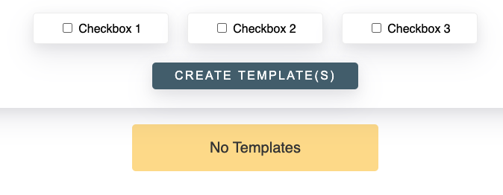
Flow:
Check box and click “Create Templates”
Click “Remove” and box removes

Slide 3
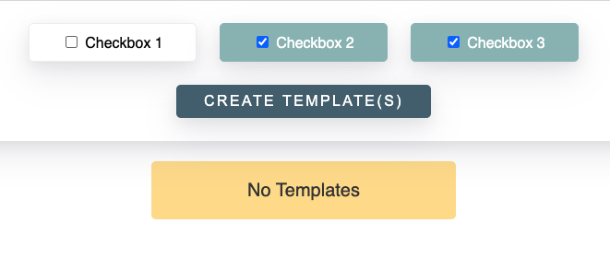
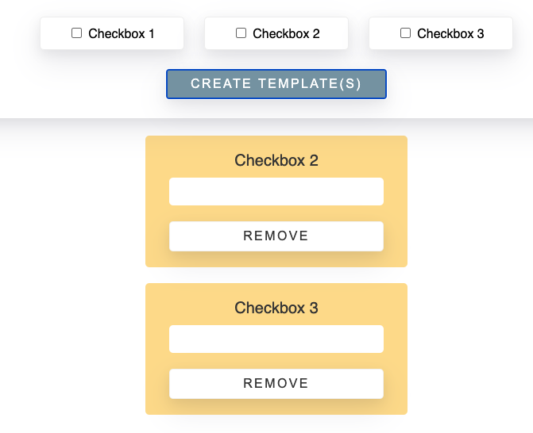
Other states:
Add multiple templates

